Slide 1

Health Monitoring System:
Using ECG and PPG Techniques…
Submitted By~ Acknowledged By~
Tushar Gupta (2000681550032) Mr.AJAY KUMAR SAH
Shagun Tyagi (2000681550029)
Kanishka Mehrotra (2000681550016)
Harshit Singhal (2000681550014)

Slide 2
Outline
Objective
IoT In Health Monitoring
Introduction
ECG Technique
PPG Technique
ECG MODEL
PPG MODEL
Components And Technology Used
SNAPSHOTS
Uses Of Health Monitoring
Target Audience
Future Updates
Target & Future Updates

Slide 3
Objective
To provide a continuous and non-invasive method for
monitoring the cardiovascular health of an individual.
Designing a low cost health monitoring kit that can measure
vital body signs like heart rate and oxygen level.

Slide 4
IoT In Health Monitoring
Emergency Response: Can be used to detect emergencies such as falls or
Seizures.
Personalised Tracking: Fitness trackers and smartwatches can track an
individual's daily activity.
Medication Adherence: Can be used to monitor a patient's medication
adherence.
Vital Sign Monitoring: Can monitor vital signs, such as heart rate, blood
pressure, oxygen levels in real-time.

Slide 5
Introduction
Continuous health monitoring is essential for people with chronic diseases as it
allows for early detection of changes.
Electrocardiogram (ECG) and Photoplethysmography (PPG) are two important
techniques used in health monitoring.
Detects abnormal heart rhythms, which can be a sign of a heart problem.
PPG is a non-invasive optical technique used to measure blood flow in the body.
ECG is a diagnostic tool that records the electrical activity of the heart.

Slide 6
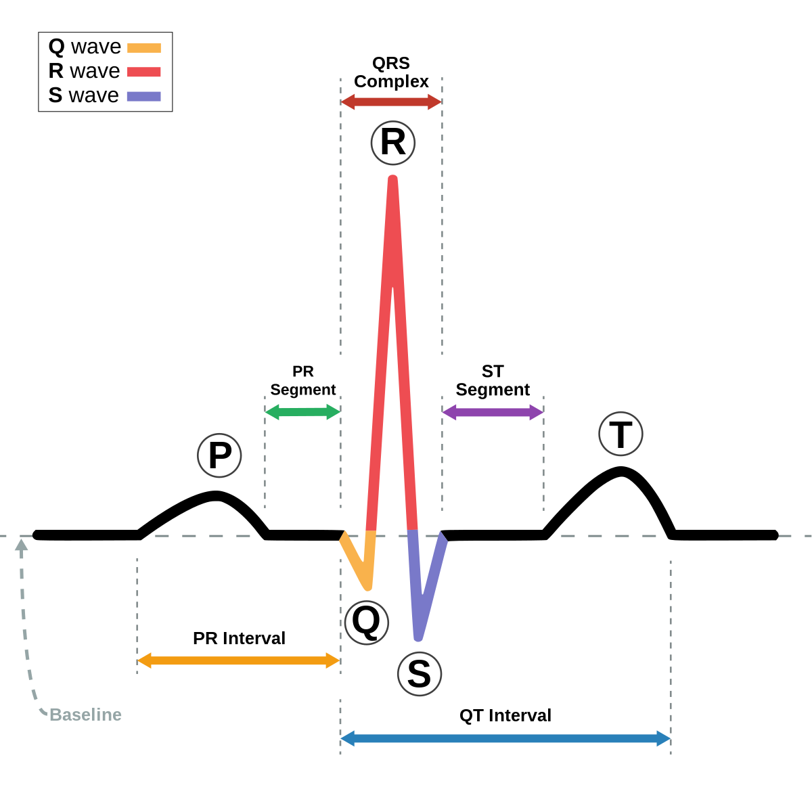
ECG Technique
ECG stands for Electrocardiogram.
Measures electrical activity of the heart.
Small metal electrodes are attached to the skin
on the chest, arms, and legs.
Electrodes detect the electrical signals produced
by the heart
Transmit them to a machine that records the
signals as a graph.
Graph determines the health of the heart and
diagnose any problems that may be present.

Slide 7
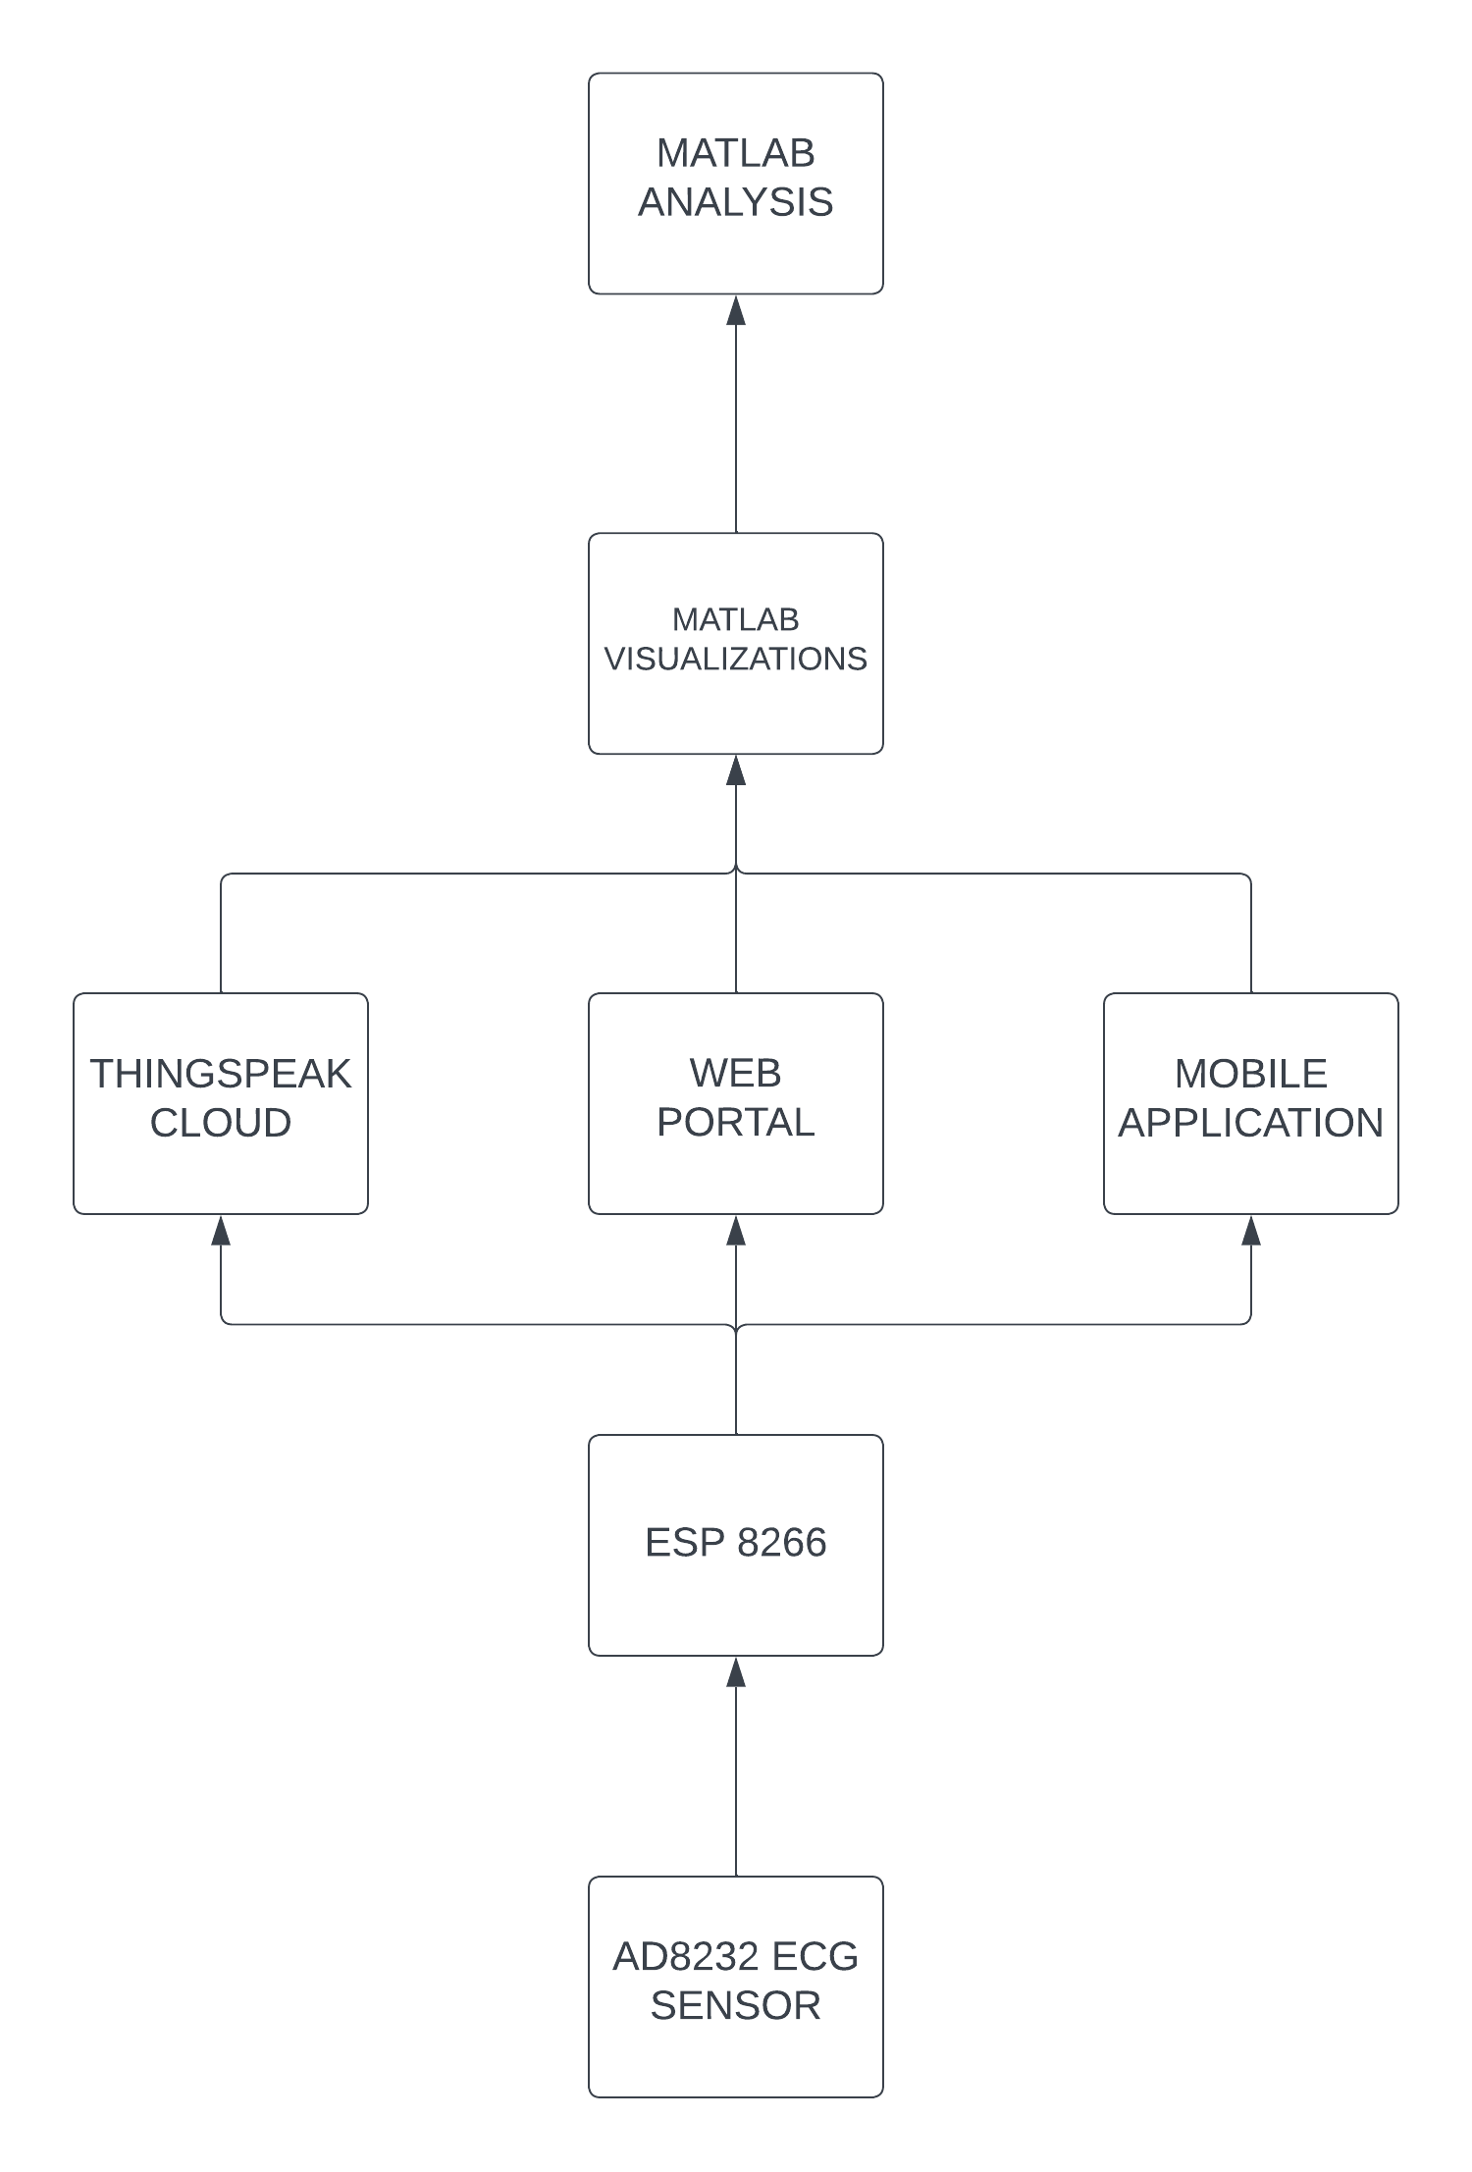
ECG BLOCK DIAGRAM

Slide 8
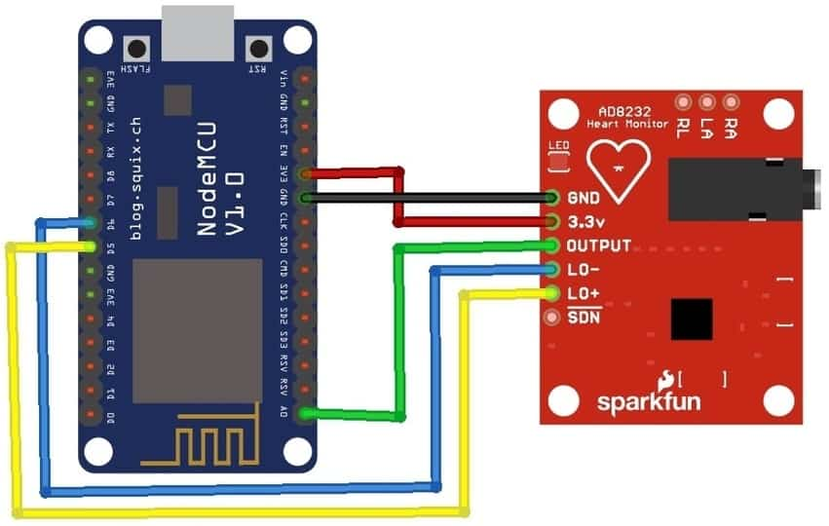
ECG MODEL

Slide 9
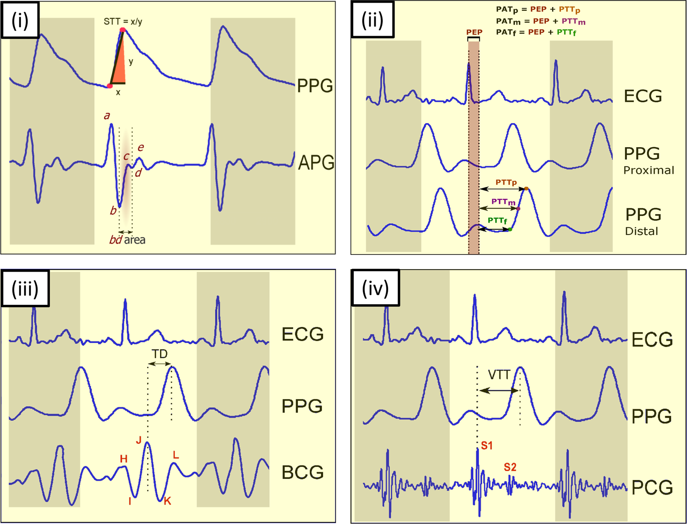
PPG Technique
PPG stands for Photoplethysmography.
Measures blood flow in the body.
A light source is shone onto the skin's surface,
usually on the fingertip or wrist.
The light is absorbed by the blood vessels
and then reflected back.
A photodiode detects the reflected light.
The photodetector converts the changes in the
light intensity into an electrical signal.
Electrical signals are processed and analysed to
determine changes in blood volume.

Slide 10
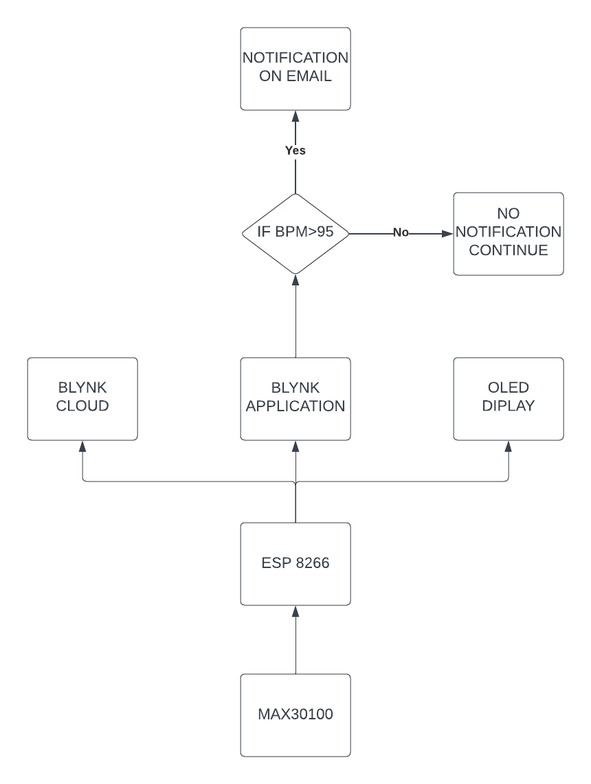
PPG BLOCK DIAGRAM

Slide 11
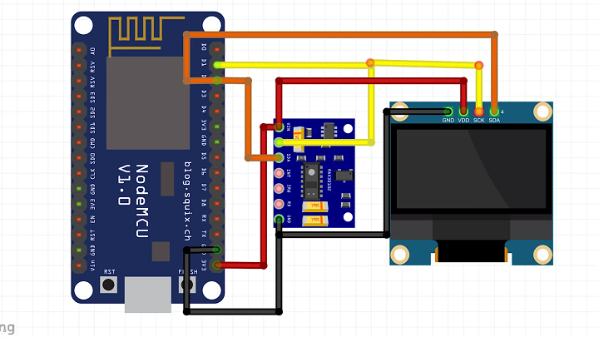
PPG MODEL

Slide 12
Components Used:
OLED Display
MAX 30100
Connecting Wires
5v Charger or Power Bank
AD8232 ECG Sensor
NODEMCU ESP8266

Slide 13
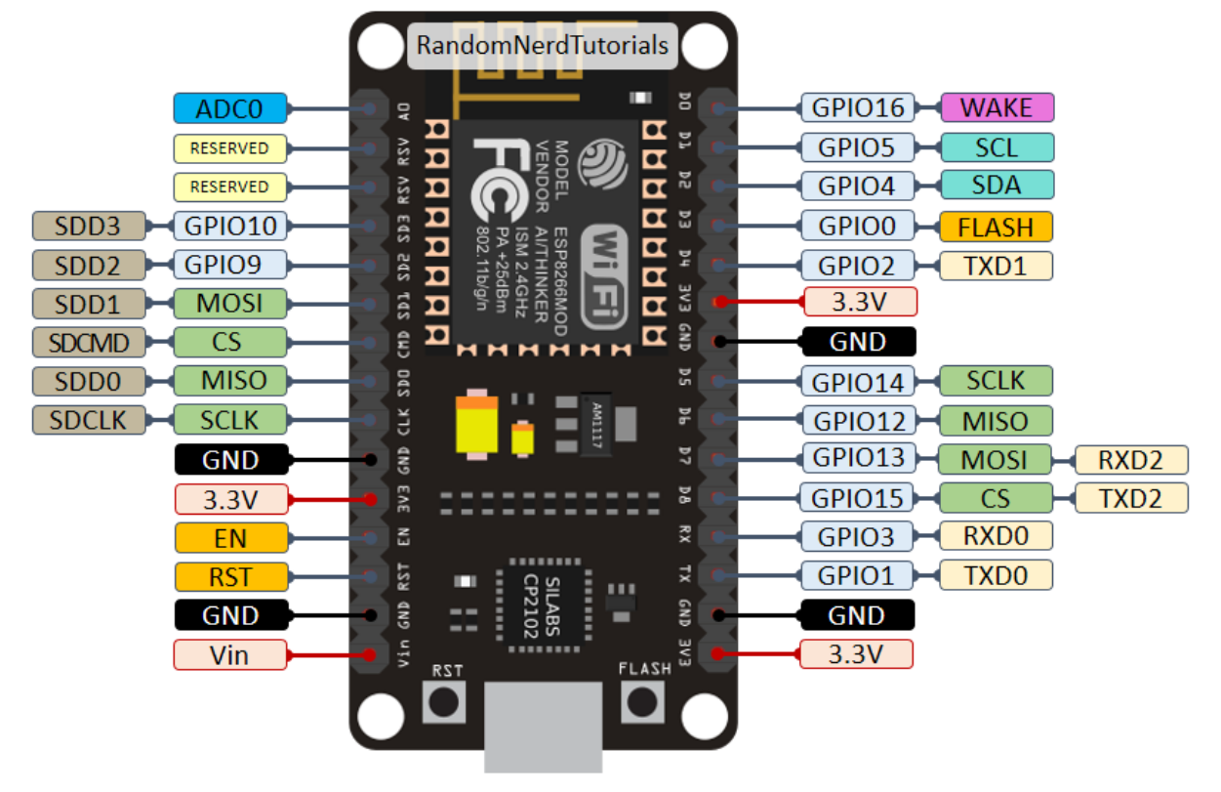
ESP 8266

Slide 14
Technology Used:
Arduino IDE
Windows OS
PPG Technique
NODEMCU ESP8266
ECG Technique
ThingSpeak
BLYNK
APPLICATION – FLUTTER
WEB PORTAL – HTML, CSS, JAVASCRIPT
DATABASE – FIREBASE
MATLAB VISUALIZATION
MATLAB ANALYSIS

Slide 15
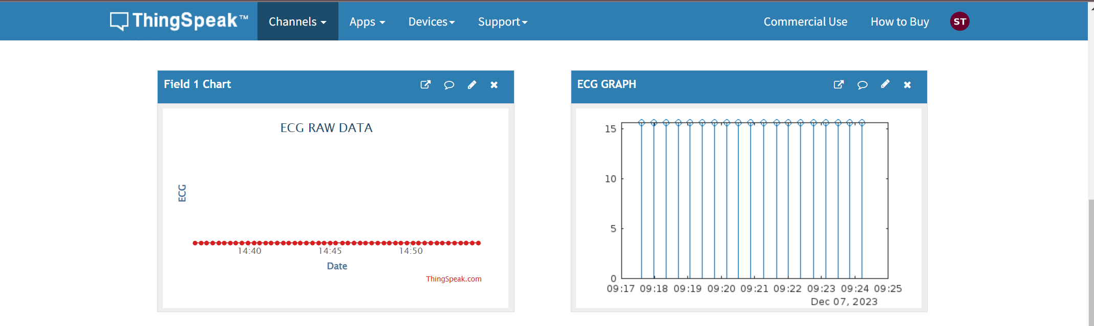
SNAPSHOTS:
FIG.THINGSPEAK PORTAL
FIG.THINGSPEAK PORTAL

Slide 16
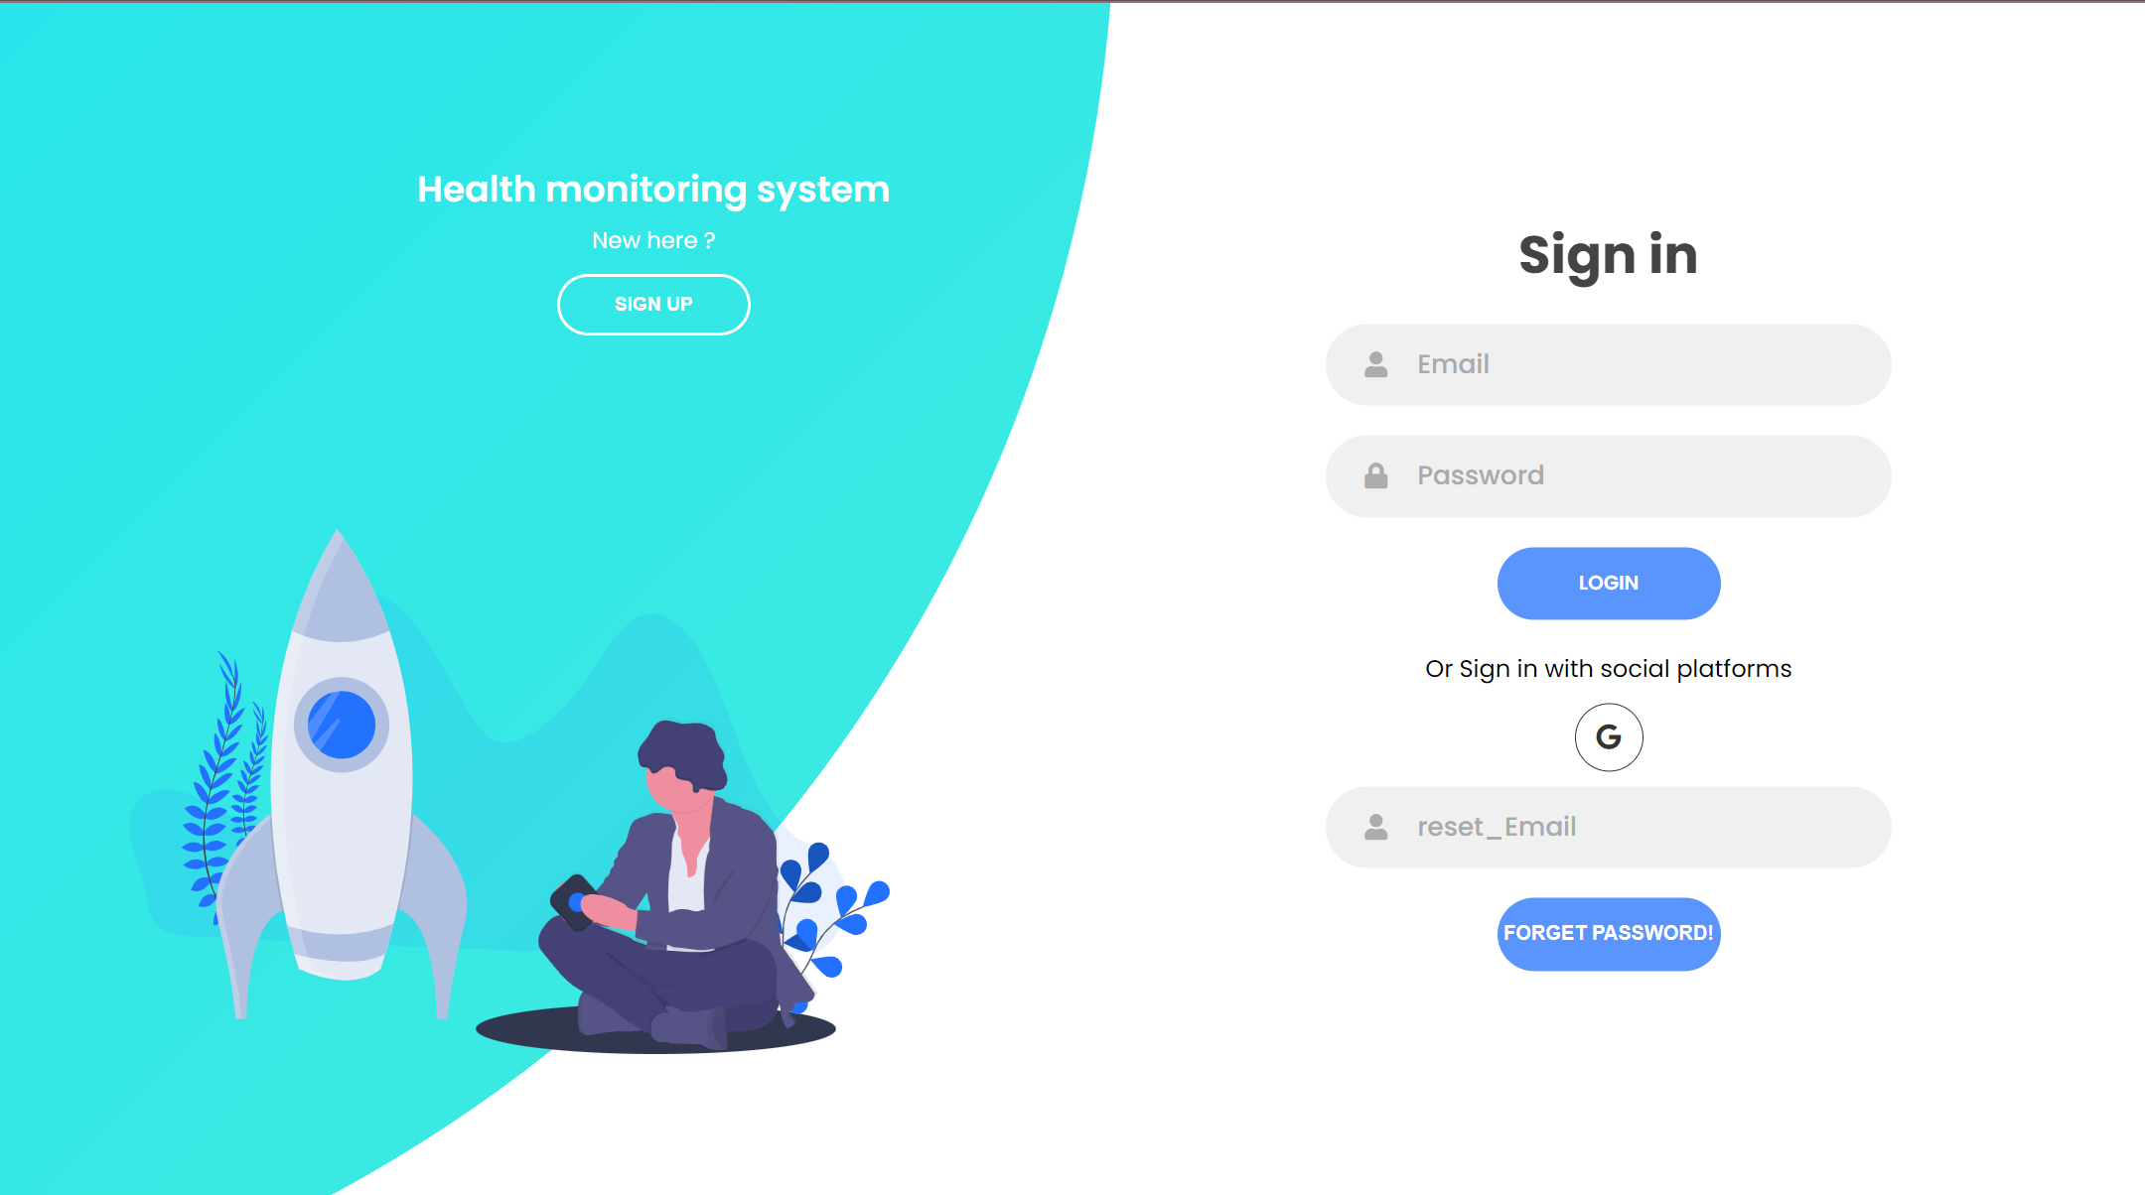

FIG.WEB PORTAL

Slide 17

FIG.MATLAB ANALYSIS

Slide 18

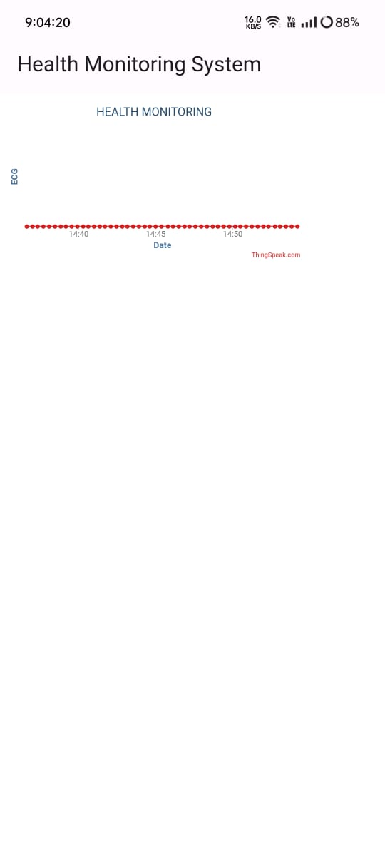
FIG.MOBILE APPLICATION

Slide 19
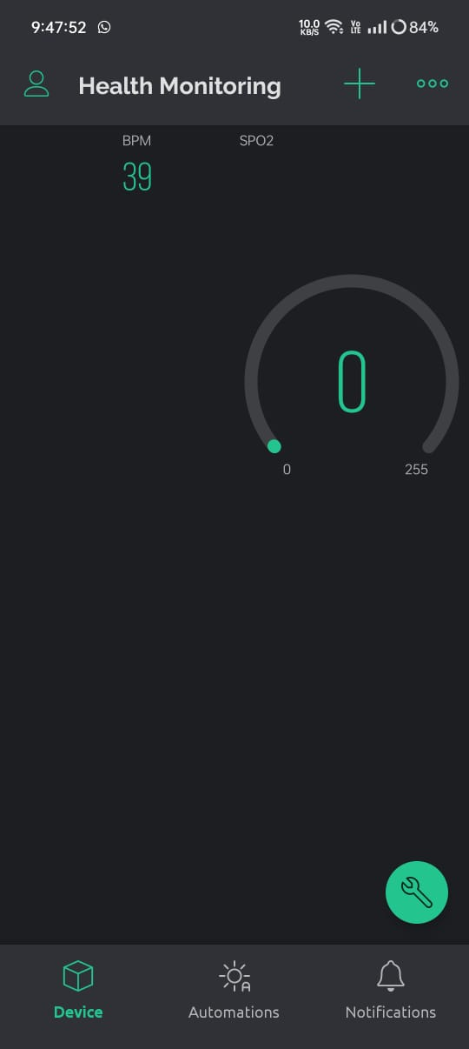
FIG.BLYNK MOBILE APPLICATION

Slide 20
Uses Of Health Monitoring
Continuous monitoring of heart rate
Detection of Arrhythmias (Irregular heartbeats)
Monitoring of blood oxygen levels
Tracking of physical activities
Real- time monitoring

Slide 21
Target Audience
Individuals with cardiovascular diseases
Athletes and fitness enthusiasts
Individuals with respiratory conditions
Senior citizens
People with chronic conditions

Slide 22
Future Updates
Wearable technology with more advanced sensors
Artificial Intelligence and Machine Learning algorithms
Improved data privacy & security
Predictive analysis

Slide 23
Thank You

